Slide 1

Final Project Reducing Commute Time with
Spark ML and GraphX
Topic: Analysis of Large Experimental Datasets with Spark
Yu, Walter
CSCI E-63 Big Data Analytics
Harvard University Extension School
Prof. Zoran B. Djordjević

Slide 2
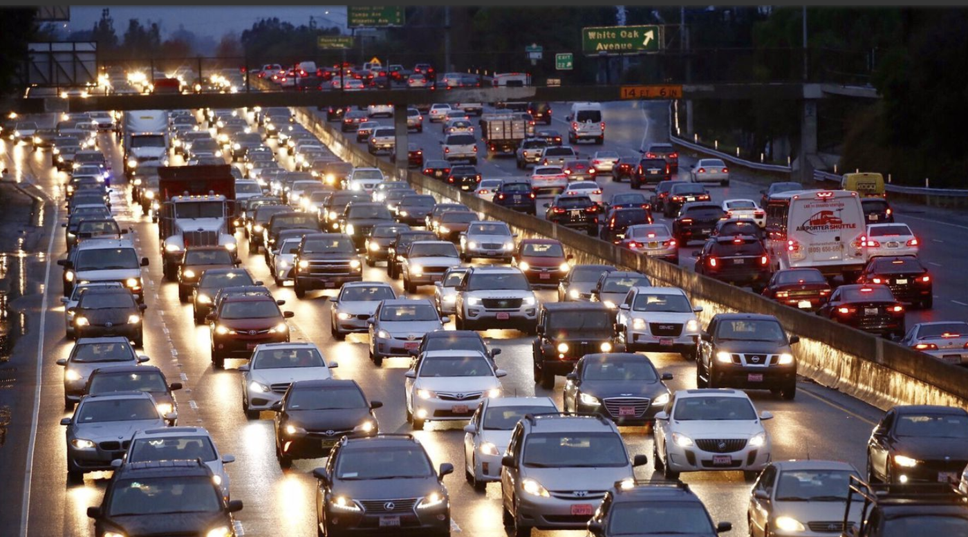
Topic and Problem Statement
Example: Predict future health care costs using the Spark Machine Learning libraries by analyzing data from the Centers for Medicare and Medicaid Services from 2008 to 2010 to predict cost savings based on the number of times a patient has visited doctors and their ailments.
Topic: “Modern scientific instrumentation collects large volumes of data. If you have access to any such data examine whether Spark would bering any benefits to the analysis.”
Problem: Reduce commute time with Spark ML and GraphX by analyzing national highway usage data to reduce negative impacts on roadway infrastructure, worker productivity, livability and the environment.
Github: https://github.com/walteryu/e63-final
Photo Reference: https://lat.ms/2zJGUGZ

Slide 3

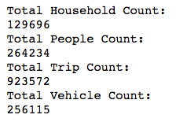

Experimental Dataset: National Household Transportation Survey (NHTS)
NHTS Dataset: https://nhts.ornl.gov/
National survey with ~1M records; ~700MB total
Project based on 2017 NHTS Data Challenge contest entry
Spark ML: Used to evaluate algorithms and feature importance to identify key factors affecting commute times
Graph Analysis: Used to evaluate relationships between census division and total vehicle trips

Slide 4

Why Spark ML?
Suitable technology to analyze reasonably large dataset; regression algorithms used to evaluate feature importance
Pros
Industry standard for rapidly analyzing large datasets by utilizing RDDs, pipelines and built-in ML algorithms
Algorithm choices are sufficient for basic analysis
Supports data pipelines within Spark/Python environment
Cons
Algorithm choices may be limited for future analysis
Scikit-Learn may be sufficient for many use cases
Data visualization is limited (Matlibplot)
Ref: https://spark.apache.org/docs/1.2.2/ml-guide.html

Slide 5

Why GraphX?
Suitable technology to analyze graph for potentially complex relationships between household and trip data tables
Pros
One of the best choices for graph analysis if working with RDDs, Python and Jupyter Notebook (Good integration)
Supports dataframes; minimal integration required
Cons
Not as full-featured as Neo4J or similar graph databases
Data visualization is limited (Matlibplot)
Ref: https://spark.apache.org/docs/1.2.2/graphx-programming-guide.html

Slide 6



All Technologies
Data Cleaning: NumPy, SciPy & Pandas
Data Visualization: Matplotlib
Spark ML: Decision Tree & Gradient-Boosted Tree Algorithms
GraphX: Vertices/Edges & In/Out-Degree Functions
Documentation: Jupyter Notebook

Slide 7
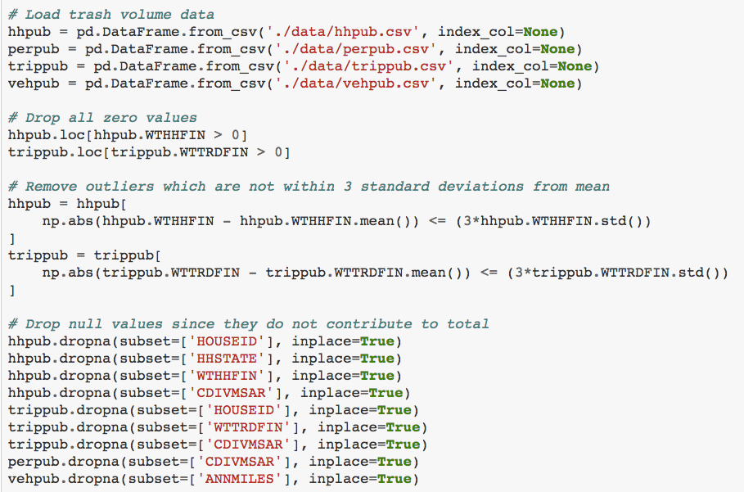
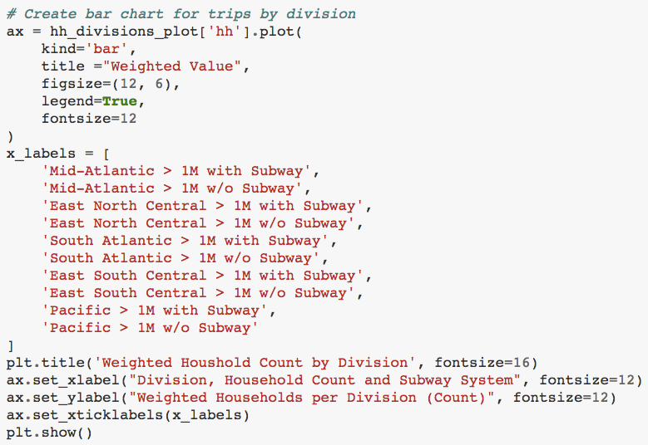
Data Analysis - Demo
<<< Code Example
Data Cleaning
Code Example >>>
Data Visualization

Slide 8
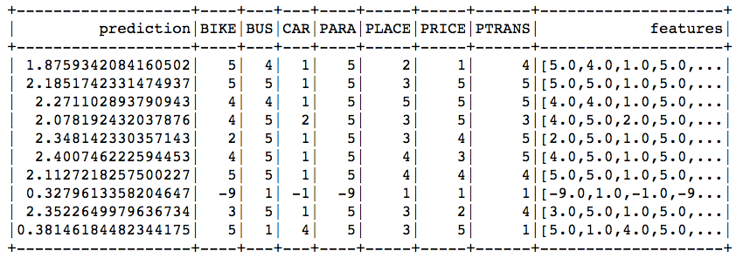
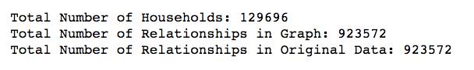
ML and Graph Analysis
Evaluate ML algorithm performance
Identify key factors with feature importance
Develop graph and calculate vertices/edges
Calculate in/out-degree relationships
Example ML Output
Feature Importance:
Example Graph
Analysis Output:

Slide 9
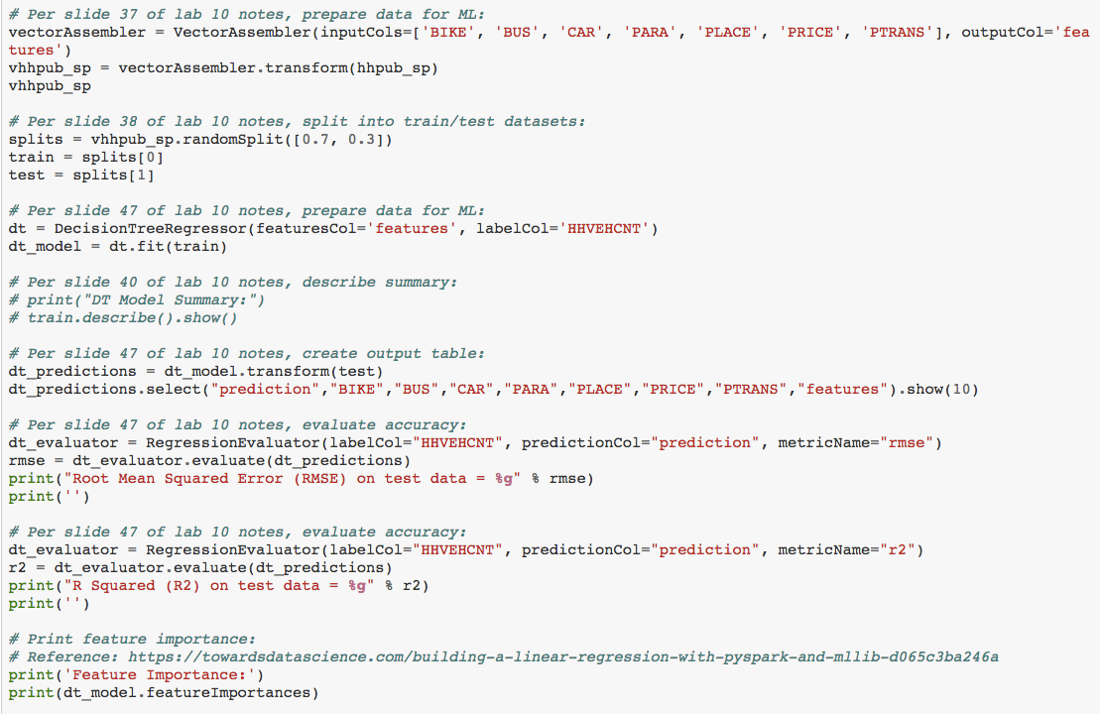
Spark ML Demo - Decision Tree Algorithm

Slide 10
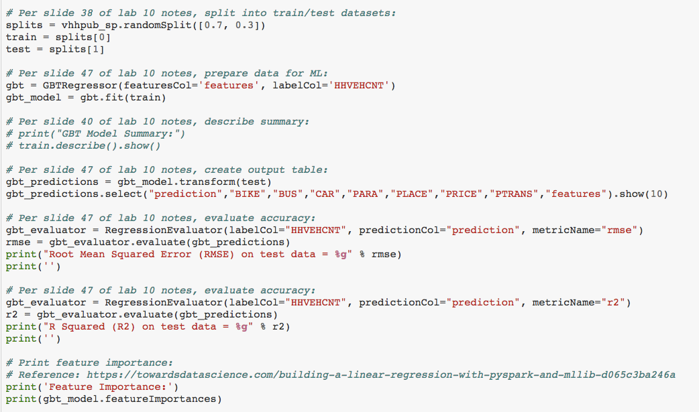
Spark ML Demo - Gradient Boosted Tree Algorithm

Slide 11
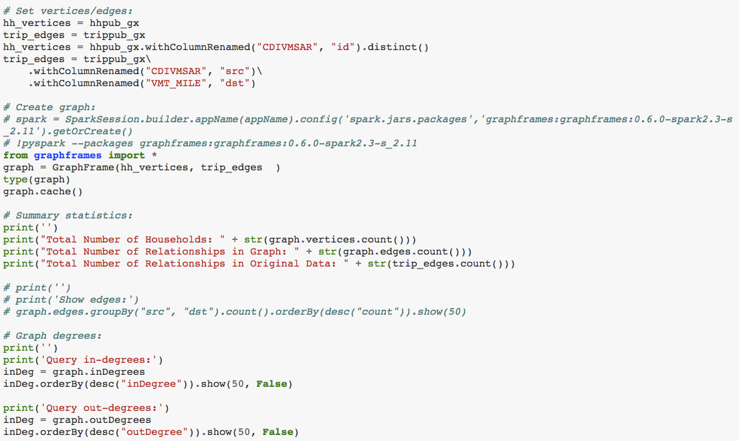
Spark GraphX Demo

Slide 12
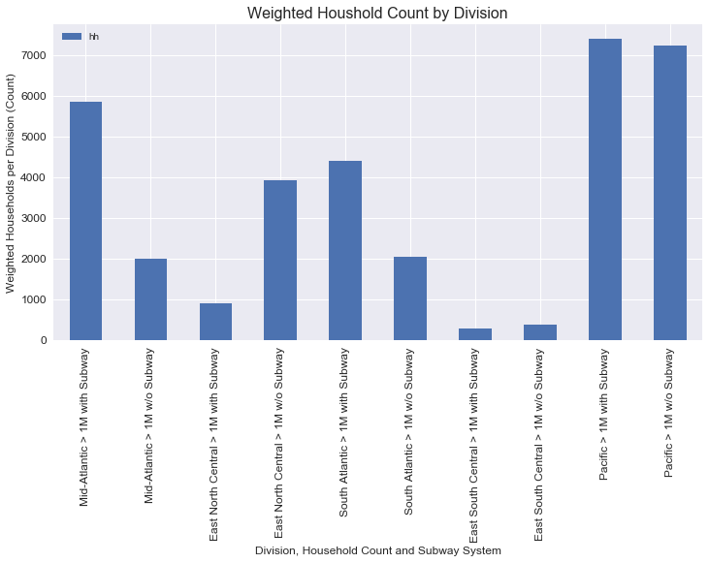
Household Data - Summary Statistics
Calculate household count by division
Separate by access to mass transit
Areas with mass transit typically have higher household count

Slide 13
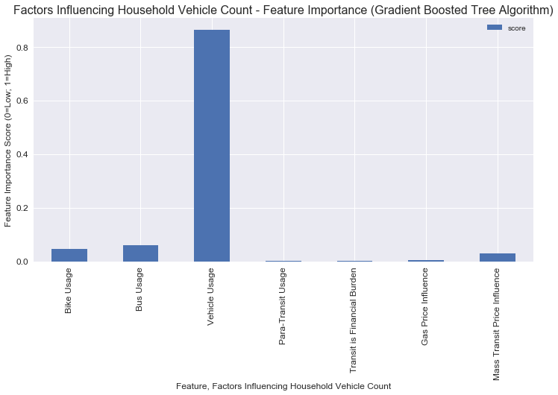
Household Data - Spark ML Feature Importance
Vehicle usage most impacts total count
Other features have low significance
Mass transit feature has low significance with vehicle usage

Slide 14
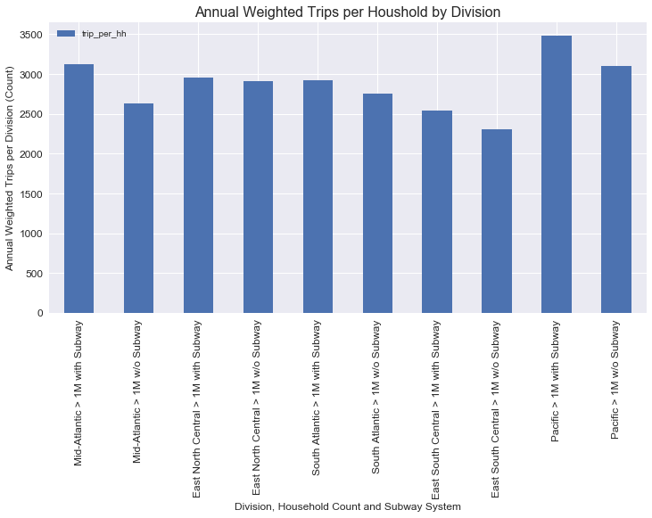
Trip Data - Summary Statistics
Calculate trip count by division
Separate by access to mass transit
Areas with mass transit typically have higher trip count

Slide 15
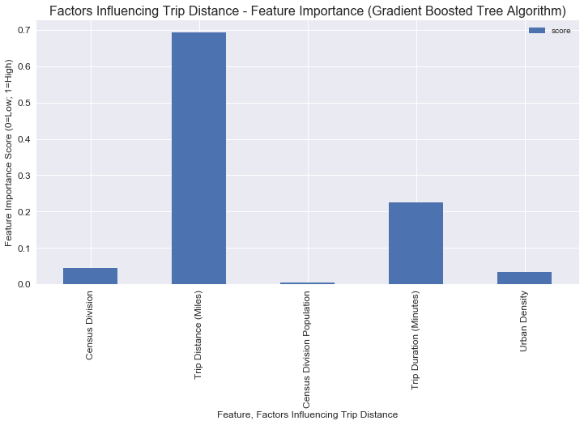
Trip Data - Spark ML Feature Importance
Trip distance most impacts vehicle miles per trip
Trip duration is also significant feature
Other features have low significance

Slide 16
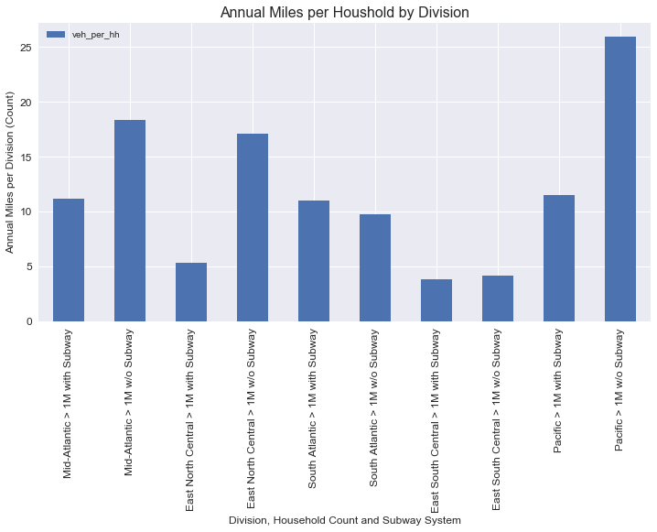
Annual Miles Driven - Summary Statistics
Calculate annual miles driven by division
Separate by access to mass transit
Areas without mass transit typically have higher miles driven

Slide 17
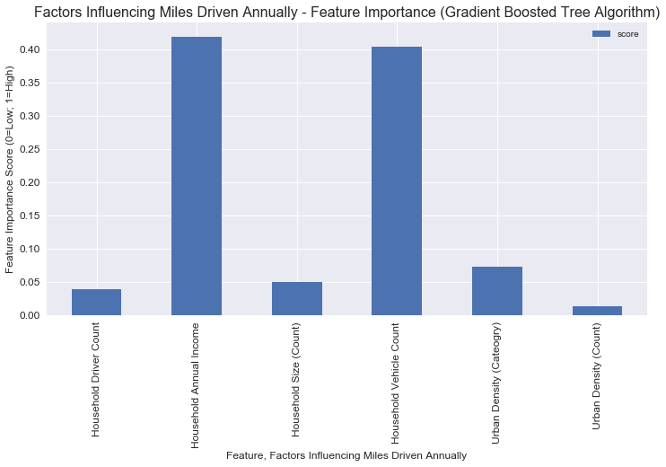
Annual Miles Drive - Spark ML Feature Importance
Annual household income and vehicle count had largest impact on annual miles driven
High income households are worth additional study
Other features have low significance

Slide 18
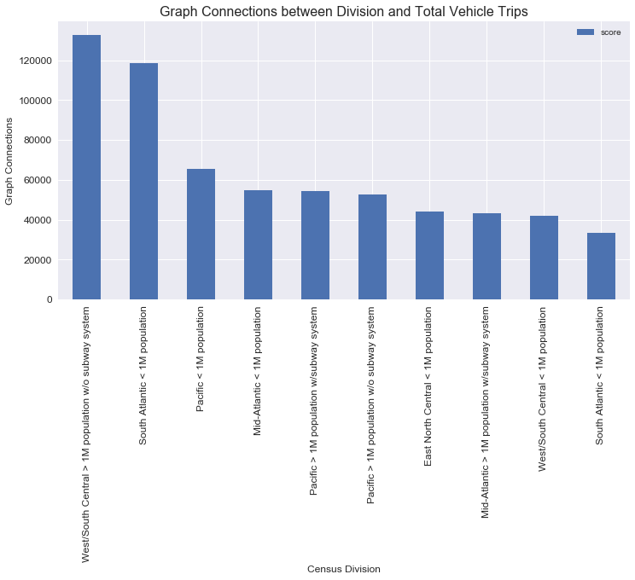
Spark GraphX - Out-Degree Relationship Count
Calculate out-degree relationships between division and total trips
Areas without mass transit and lower population have highest trip count
Mass transit and urban density may reduce trip count

Slide 19
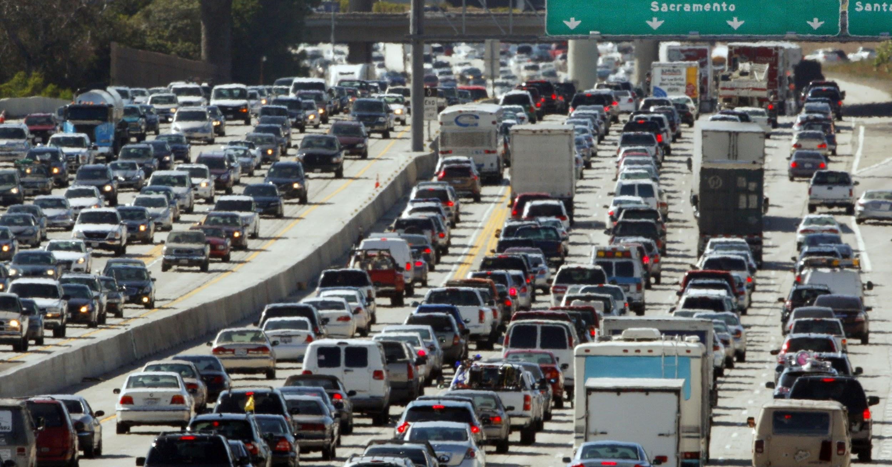
Observations
Photo Reference: http://bit.ly/2DZ2avA
Mass transit does not appear to directly influence driving behavior; however, trip distance/length has high significance
Urban areas have higher population so appear to have higher total trips but shorter distances; rural areas have lower population so have lower total trips but longer distances
Households with higher income appear to have higher vehicle count and usage; trip destination also has significance

Slide 20

Recommendations
Photo Reference: http://bit.ly/2E2N7Rh
Public education is recommended to raise awareness
Results may be useful to urban planners
Encourage households to take action by living near urban areas instead of relying on urban planning to solve problem
Mass transit alone is unlikely to reduce vehicle usage; actions to change driving behavior are recommended

Slide 21
YouTube URLs, Last Page
Two minute (short):
15 minutes (long):

